Slide 1



C# Advanced Topics
Methods, Classes and Objects
SoftUni Team
Technical Trainers
Software University
http://softuni.bg

Slide 2

Table of Contents
A very brief introduction to:
Methods
Utilizing a piece of code multiple times
Using Built-in .NET Classes
Defining Simple Classes
Making real life objects into code

Slide 3
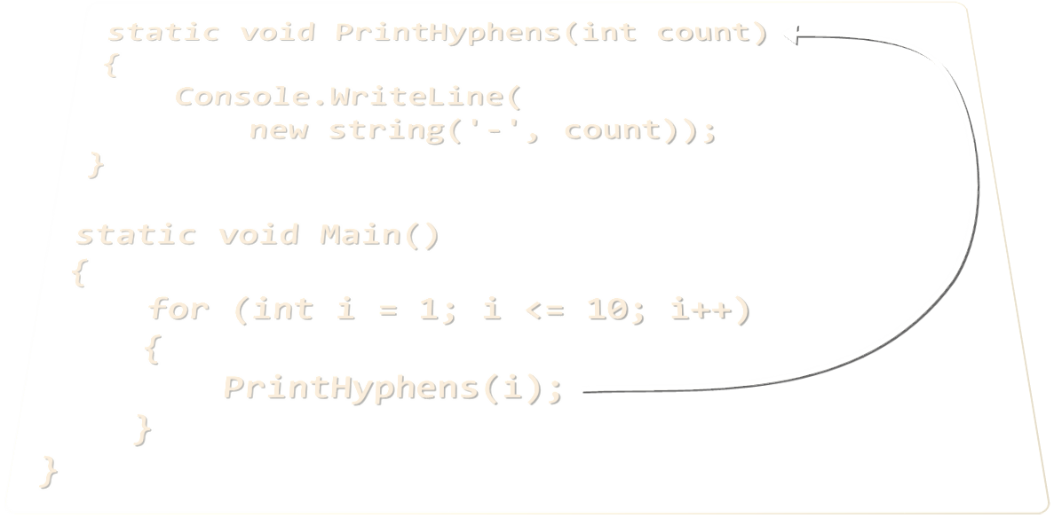
Methods
Defining and Invoking Methods

Slide 4
What are methods?
Methods are named pieces of code
Defined in the class body
Can be invoked multiple times
Can take parameters
Can return a value
static void PrintHyphens(int count)
{
Console.WriteLine(
new string('-', count));
}
static void Main()
{
for (int i = 1; i <= 10; i++)
{
PrintHyphens(i);
}
}

Slide 5
How to define a method
Parts of a method:
Return type
Method name
Method parameters
public double calcTriangleArea (double a, double h)
{
double area = a * h / 2;
return area;
}
Return value

Slide 6

Void return type
The void return type means that:
Will not return a value
Will only execute some code without creating a new value
public void printName(string firstName, string lastName)
{
Console.WriteLine("My full name is: {0} {1}",
firstName, lastName);
}

Slide 7
Methods with Parameters and Return Value
static double CalcTriangleArea(double width, double height)
{
return width * height / 2;
}
static void Main()
{
Console.Write("Enter triangle width: ");
double width = double.Parse(Console.ReadLine());
Console.Write("Enter triangle height: ");
double height = double.Parse(Console.ReadLine());
Console.WriteLine(CalcTriangleArea(width, height));
}

Slide 8
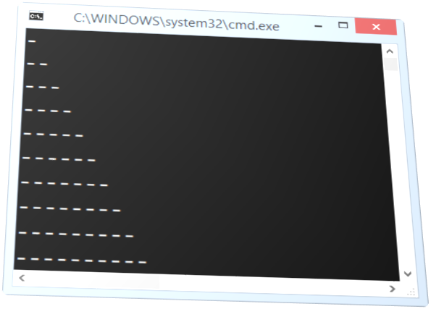
Methods
Live Demo

Slide 9
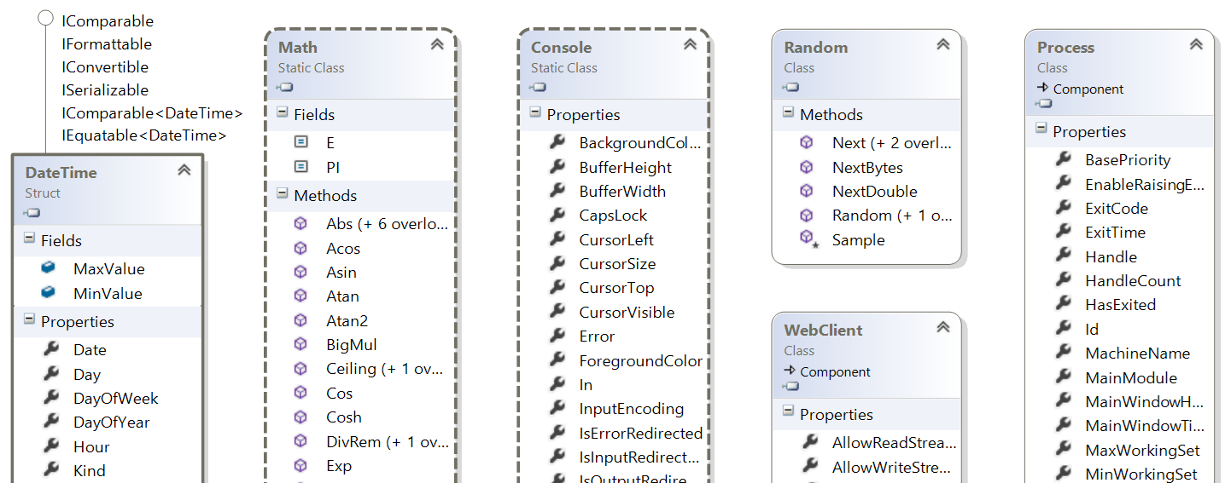
Using Built-in .NET Classes
Math, Random, Console, etc.

Slide 10
Built-in Classes in .NET Framework
.NET Framework provides thousands of ready-to-use classes
Packaged into namespaces like System, System.Net, System.Collections, System.Linq, etc.
Using static .NET classes:
Using non-static .NET classes
DateTime today = DateTime.Now;
double cosine = Math.Cos(Math.PI);
Random rnd = new Random();
int randomNumber = rnd.Next(1, 99);

Slide 11
Built-in .NET Classes – Examples
DateTime today = DateTime.Now;
Console.WriteLine("Today is: " + today);
DateTime tomorrow = today.AddDays(1);
Console.WriteLine("Tomorrow is: " + tomorrow);
double angleDegrees = 60;
double angleRadians = angleDegrees * Math.PI / 180;
Console.WriteLine(Math.Cos(angleRadians));
Random rnd = new Random();
Console.WriteLine(rnd.Next(1,100));
WebClient webClient = new WebClient();
webClient.DownloadFile("http://…", "file.pdf");
Process.Start("file.pdf");

Slide 12
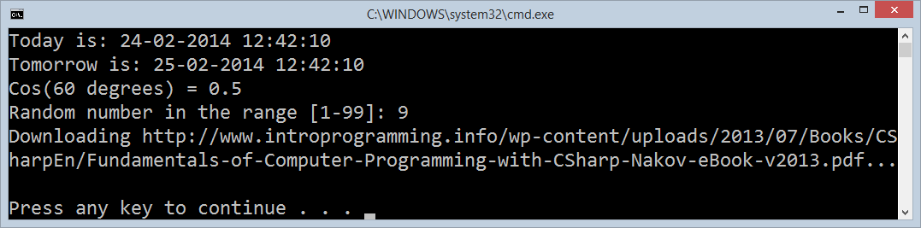
Using Built-in .NET Classes
Live Demo

Slide 13
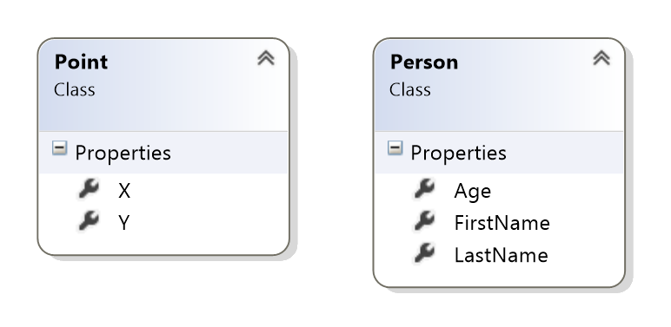
Defining Simple Classes
Using Classes to Hold a Set of Fields

Slide 14
Classes in C#
Classes in C# combine a set of named fields / properties
Defining a class Point holding X and Y coordinates:
Creating class instances (objects):
class Point
{
public int X { get; set; }
public int Y { get; set; }
}
Point start = new Point() { X = 3, Y = 4 };
Point end = new Point() { X = -1, Y = 5 };

Slide 15
Arrays of Objects
We can create arrays and lists of objects:
Point[] line = new Point[]
{
new Point() { X = -2, Y = 1 },
new Point() { X = 1, Y = 3 },
new Point() { X = 4, Y = 2 },
new Point() { X = 3, Y = -2 },
};
for (int i = 0; i < line.Length; i++)
{
Console.WriteLine("Point(" + line[i].X + ", " + line[i].Y + ")");
}

Slide 16
Defining and Using Classes – Example
class Person
{
public string FirstName { get; set; }
public string LastName { get; set; }
public int Age { get; set; }
}
…
Person[] people = new Person[]
{
new Person() { FirstName = "Larry", LastName = "Page", Age = 40},
new Person() { FirstName = "Steve", LastName = "Jobs", Age = 56},
new Person() { FirstName = "Bill", LastName = "Gates", Age = 58},
};

Slide 17
Defining and Using Classes – Example (2)
Console.WriteLine("Young people: ");
foreach (var p in people)
{
if (p.Age < 50)
{
Console.WriteLine("{0} (age: {1})", p.LastName, p.Age);
}
}
var youngPeople = people.Where(p => p.Age < 50);
foreach (var p in youngPeople)
{
Console.WriteLine("{0} (age: {1})", p.LastName, p.Age);
}

Slide 18
Defining and Using Simple Classes
Live Demo

Slide 19

Summary
Methods are reusable named code blocks
Can return different type of data
.NET Framework provides a rich class library
Math, Random, DateTime, System.Linq
Classes combine a set of fields into a single structure
Objects are instances of classes

Slide 20







C# Advanced Topics
http://softuni.bg/courses/csharp-basics

Slide 21
License
This course (slides, examples, demos, videos, homework, etc.) is licensed under the "Creative Commons Attribution-NonCommercial-ShareAlike 4.0 International" license
Attribution: this work may contain portions from
"Fundamentals of Computer Programming with C#" book by Svetlin Nakov & Co. under CC-BY-SA license

Slide 22





Free Trainings @ Software University
Software University Foundation – softuni.org
Software University – High-Quality Education, Profession and Job for Software Developers
softuni.bg
Software University @ Facebook
facebook.com/SoftwareUniversity
Software University @ YouTube
youtube.com/SoftwareUniversity
Software University Forums – forum.softuni.bg

